Slide 1
Analyzing Global Causes of Death
Presented by: Rajvir Kaur

Slide 2
Introduction
Mortality patterns provide critical insights into the health challenges faced by different populations across the world.
Understanding the leading causes of death helps governments, healthcare organizations, and researchers develop better public health policies, allocate resources efficiently, and implement interventions to reduce preventable deaths.
Notes:
This means that analyzing mortality patterns (how and why people die) helps us understand the major health issues affecting populations globally.

Slide 3

Dataset Overview and cleaning
The dataset consist of 32 columns and 6121 rows for each death cause from year 1990–2019.
This data is downloaded from our world data website.
The dataset covers a broad spectrum of causes, including
Infectious diseases (such as tuberculosis, malaria, and meningitis),
Non-communicable diseases (such as cardiovascular diseases, diabetes, and cancer),
External causes (such as road injuries, drowning, and self-harm), and maternal
and neonatal conditions.
Notes:
This analysis explores global mortality trends by examining the leading causes of death across different countries and time periods.

Slide 4
Research Questions:
What are the leading causes of mortality worldwide?
How have the primary causes of death evolved over the years?
Which nations report the highest mortality rates?
What are the differences in mortality patterns between infectious diseases and chronic illnesses?
How can machine learning models be used to forecast future cardiovascular disease trends?
Notes:
Mortality Rate: The number of deaths in a specific population over a given period, usually expressed per 1,000 or 100,000 people.

Slide 5
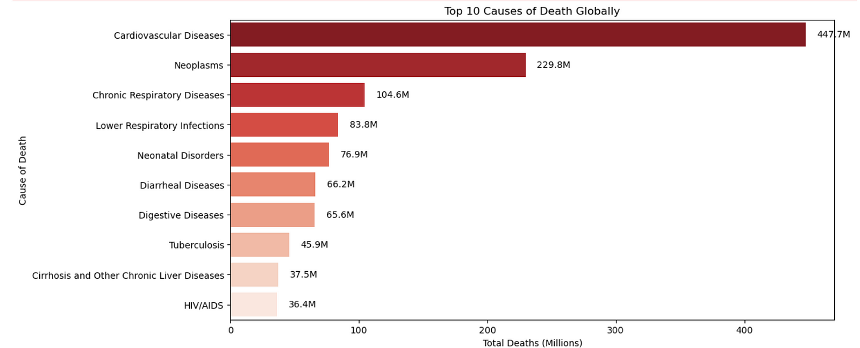
What are the leading causes of mortality worldwide?
Cardiovascular Diseases are the leading cause of death, with 447.7 million deaths recorded globally.
Notes:
This bar chart represents the top 10 causes of death globally.
Cardiovascular Diseases responsible for millions of deaths each year.
Coronary Artery Disease (CAD) – Blockages in the arteries supplying the heart, leading to heart attacks.
Stroke – Disruption of blood flow to the brain due to a clot or rupture.
Heart Failure – The heart's inability to pump blood effectively.
Hypertension (High Blood Pressure) – A major risk factor for heart disease and stroke.
Arrhythmias – Irregular heartbeats that can lead to complications.

Slide 6
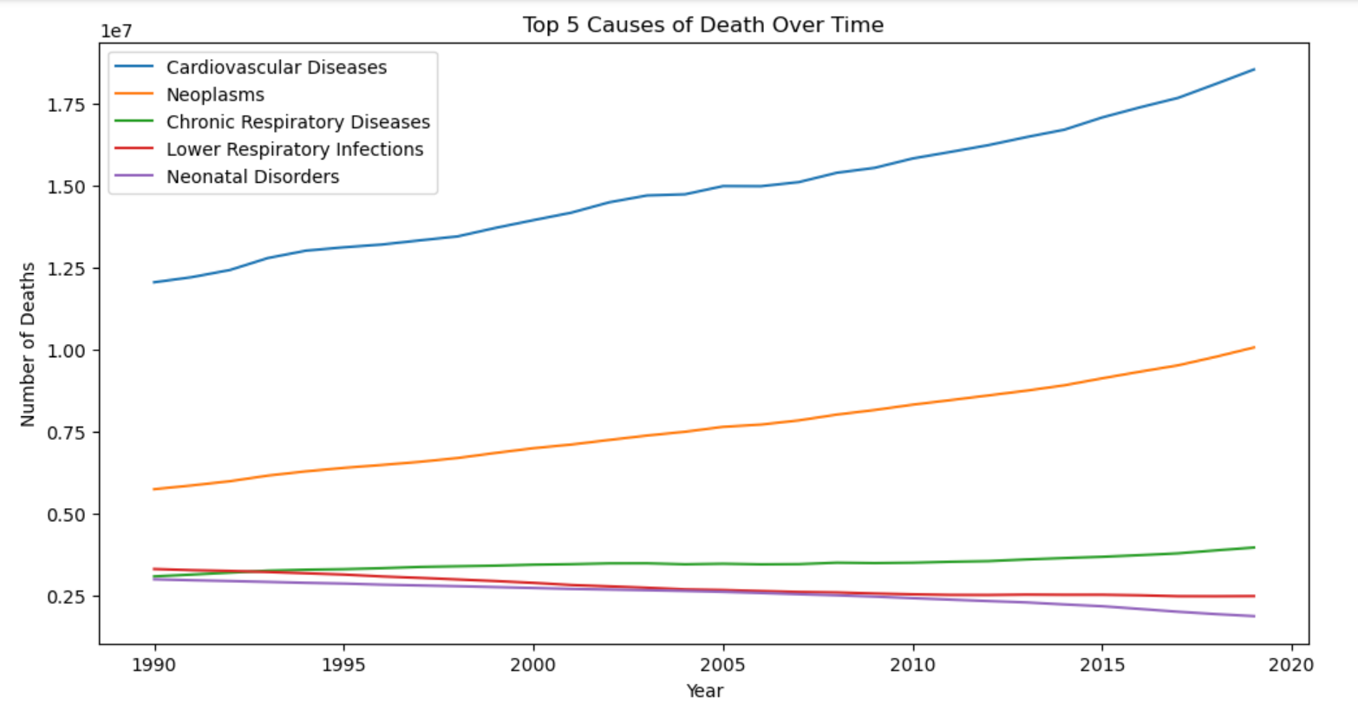
How have the primary causes of death evolved over the years?
Cardiovascular Diseases remain the leading cause of death, steadily increasing over time.
Notes:
The line graph visualizes the top 5 causes of death from around 1990 to 2020.
Overall Trend: Non-communicable diseases (NCDs) are becoming major global health issue, while some infectious diseases show a decline

Slide 7
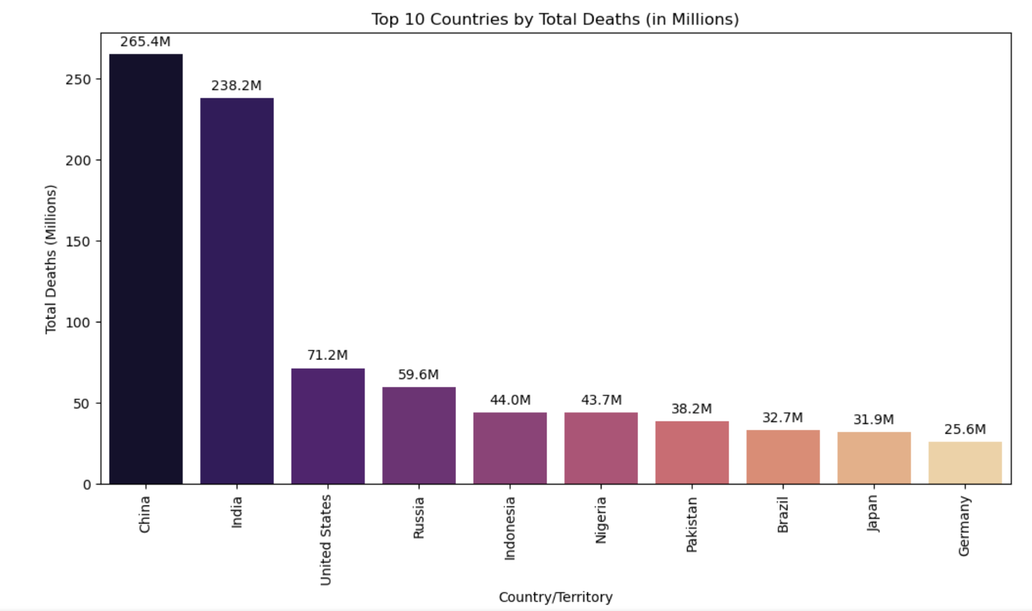
Which nations report the highest mortality rates?
China and India have the highest total deaths, with 265.4 million and 238.2 million deaths,
Notes:
This graph represents the top 10 countries by total deaths.
China and India have the highest total deaths, with 265.4 million and 238.2 million deaths, respectively, significantly surpassing all other countries.

Slide 8
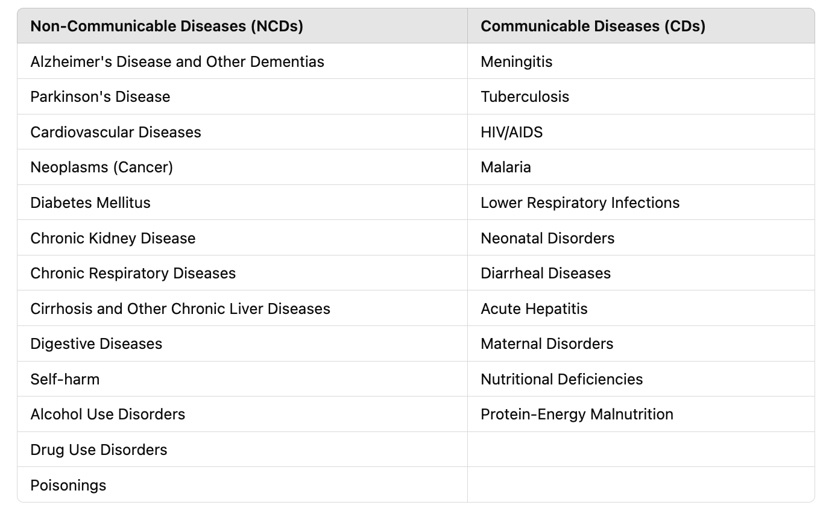
How do mortality trends differ between communicable and non-communicable diseases?
Notes:
🔹 Non-Communicable Diseases (NCDs): Chronic diseases that are not infectious and cannot be transmitted from person to person. They are often caused by lifestyle factors, genetics, or environmental influences. Examples include heart disease, cancer, diabetes, and chronic respiratory diseases.
🔹 Communicable Diseases (CDs): Infectious diseases caused by bacteria, viruses, fungi, or parasites that can spread from one person to another through air, water, food, direct contact, or vectors. Examples include influenza, tuberculosis, malaria, and COVID-19.
Examples of Chronic Diseases
🔹 Cardiovascular Diseases – Heart disease, hypertension, stroke. 🔹 Cancer – Breast cancer, lung cancer, colorectal cancer. 🔹 Diabetes – Type 1 and Type 2 diabetes. 🔹 Chronic Respiratory Diseases – Asthma, chronic obstructive pulmonary disease (COPD). 🔹 Kidney Disease – Chronic kidney disease (CKD). 🔹 Neurological Disorders – Alzheimer’s disease, Parkinson’s disease.

Slide 9
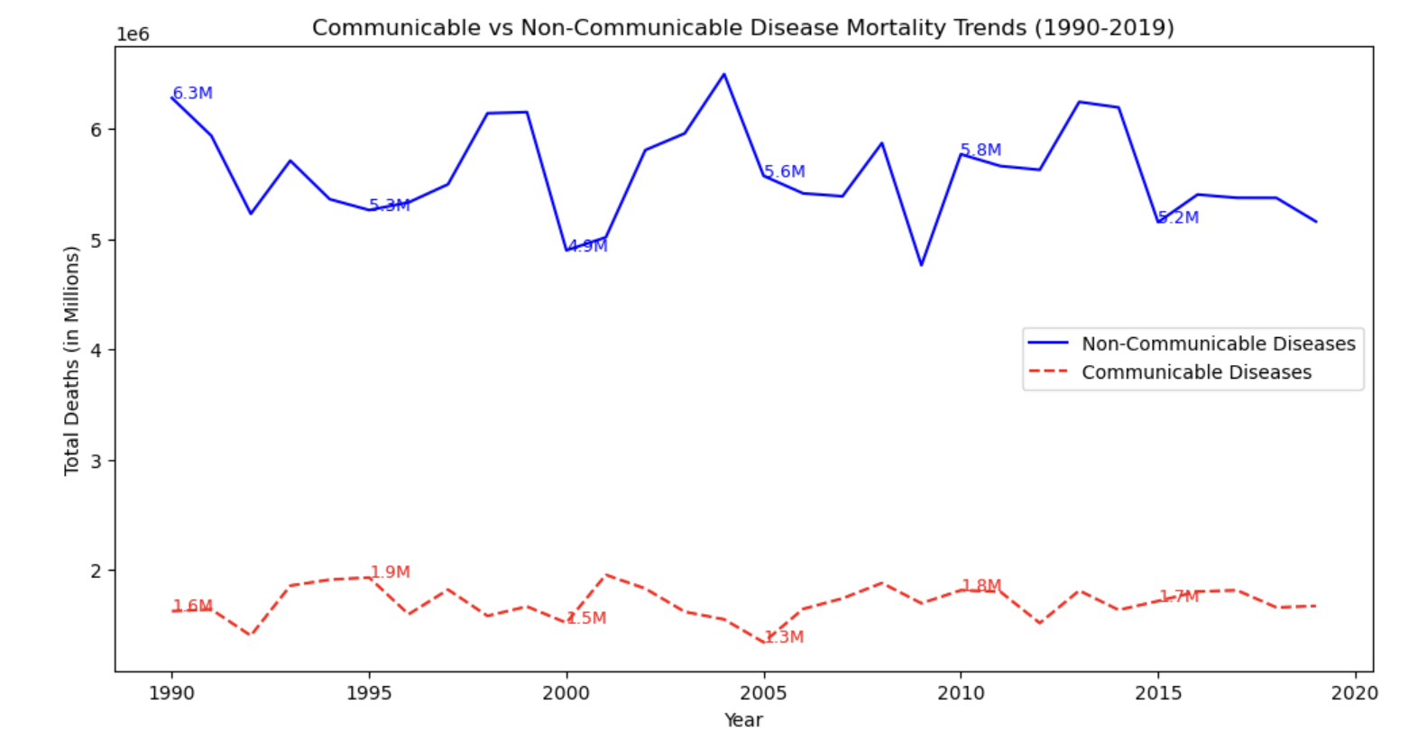
NCDs consistently have a higher number of deaths, ranging from 5.4M to 6.4M, while CDs remain lower, fluctuating between 1.6M and 1.8M.
Notes:
The graph shows mortality trends for non-communicable diseases (NCDs) and communicable diseases (CDs) from 1990 to 2019.
Medical advancements have reduced CD deaths, but NCDs remain a major public health issue. Aging populations, urbanization, and lifestyle changes contribute to their increase.
The statement means that medical progress (such as vaccines, antibiotics, and improved healthcare) has helped reduce deaths caused by communicable diseases (CDs) like infections. However, non-communicable diseases (NCDs)—such as heart disease, diabetes, and cancer—are still a major health concern.

Slide 10

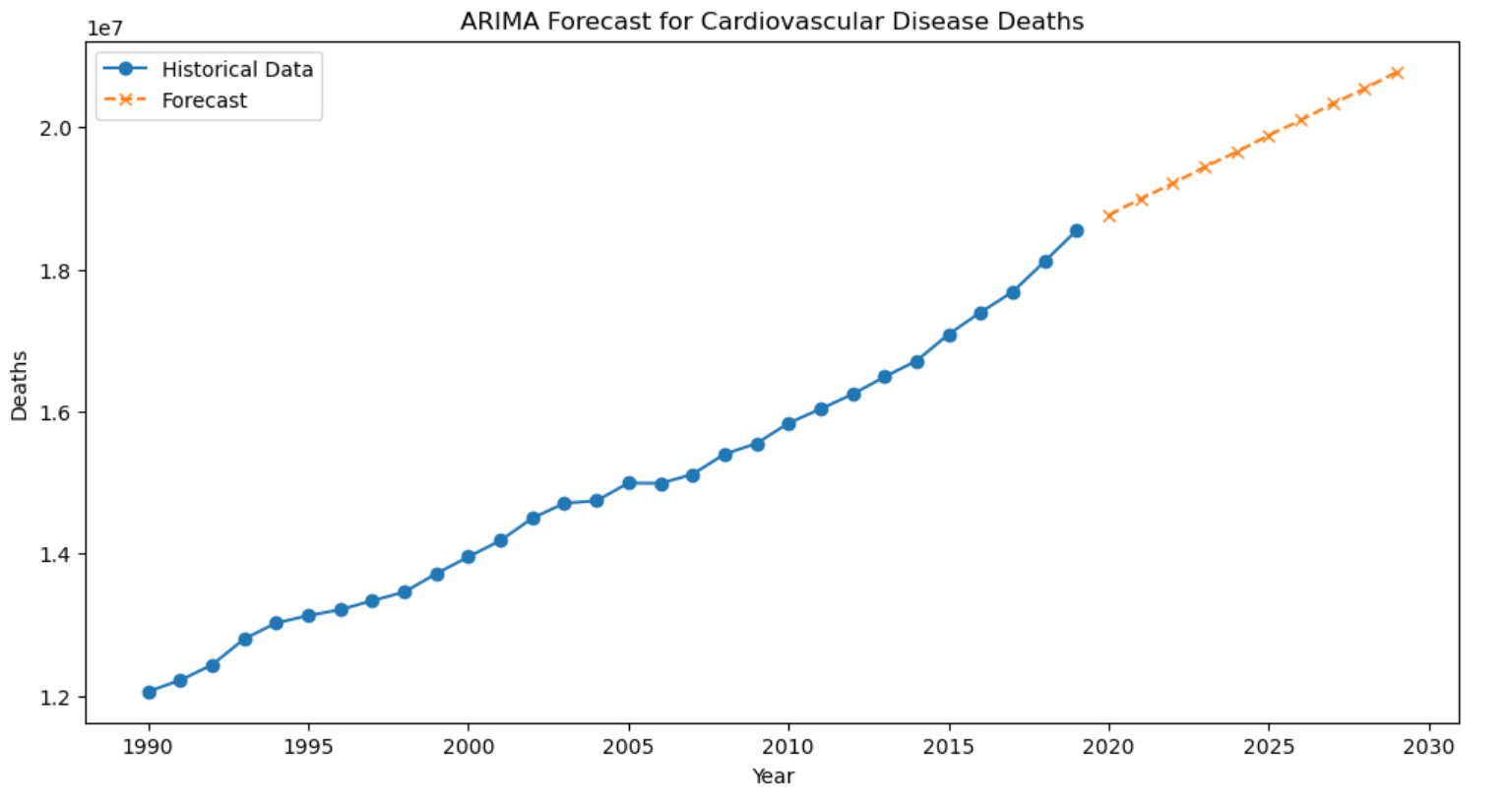
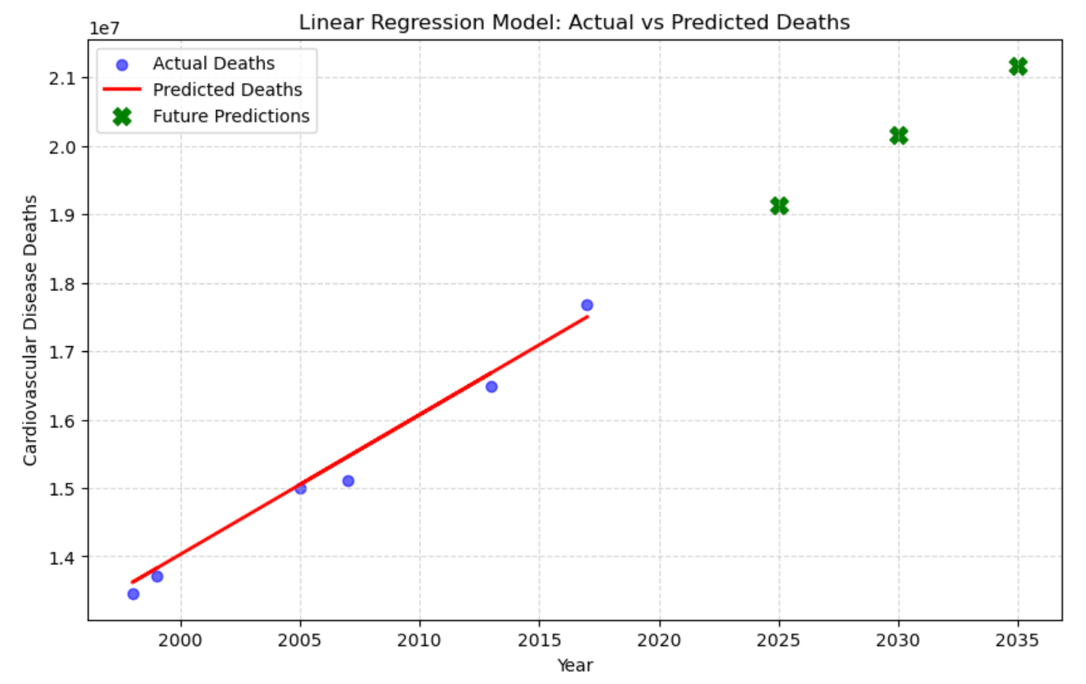
How can machine learning models be used to forecast future cardiovascular disease trends?
The trend suggests an increasing number of deaths due to cardiovascular diseases over time.
Continuous rise in deaths, exceeding 2.1 million deaths per year by 2035.
Model Used are :
Linear Regression model
ARIMA (Autoregressive Integrated Moving Average)
Notes:
If this trend continues, cardiovascular diseases will remain a major global health challenge.
Future research should focus on identifying key risk factors contributing to this increase and implementing strategies to reduce them.

Slide 11
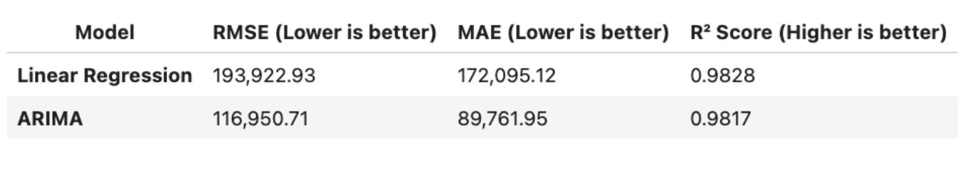
Comparison between models
Root Mean Squared Error (RMSE) and Mean Absolute Error (MAE) for ARIMA are lower, which means it produces more accurate predictions.
ARIMA has better forecasting accuracy due to its time-series modelling capabilities.
For predicting cardiovascular disease deaths in the future, ARIMA is the better choice.
Notes:
Final Verdict:
✔ If the goal is forecasting future deaths, ARIMA is the preferred model due to lower prediction errors. ✔ If the goal is interpreting historical trends, Linear Regression is slightly better. ✔ For predicting cardiovascular disease deaths in the future, ARIMA is the better choice.

Slide 12
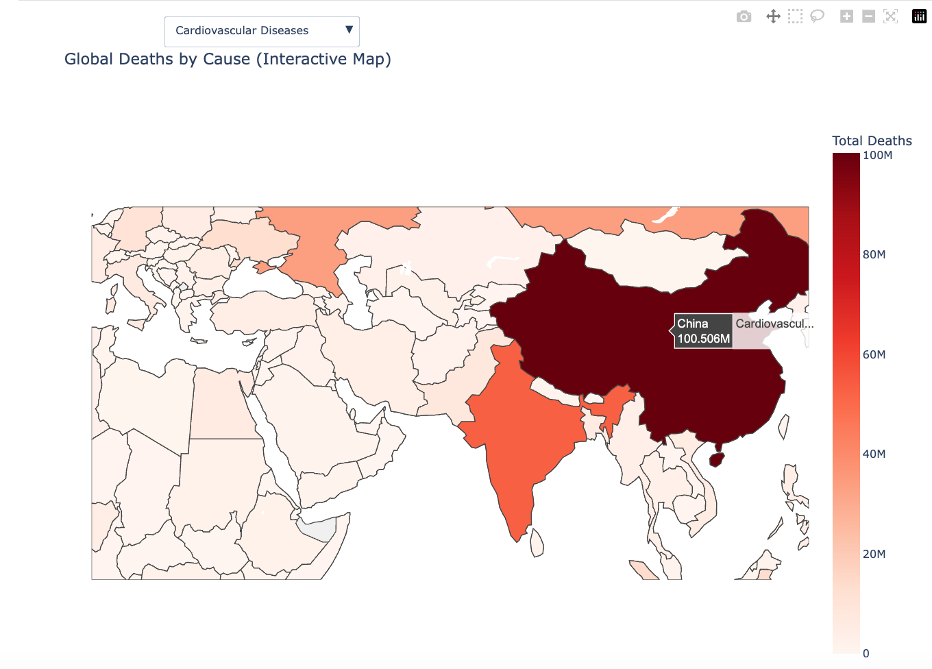
Global Mortality Analysis: Interactive Map of Leading Causes of Death by Country
The map visualizes the number of deaths per country for selected causes, helping identify regions with high mortality rates.
Notes:
Users can switch between different causes (Cardiovascular Diseases, Neoplasms, Lower Respiratory Infections, Neonatal Disorders, and Tuberculosis) to see how different diseases impact various countries.
Countries with the darkest red shades indicate the highest number of deaths.
Choropleth map

Slide 13
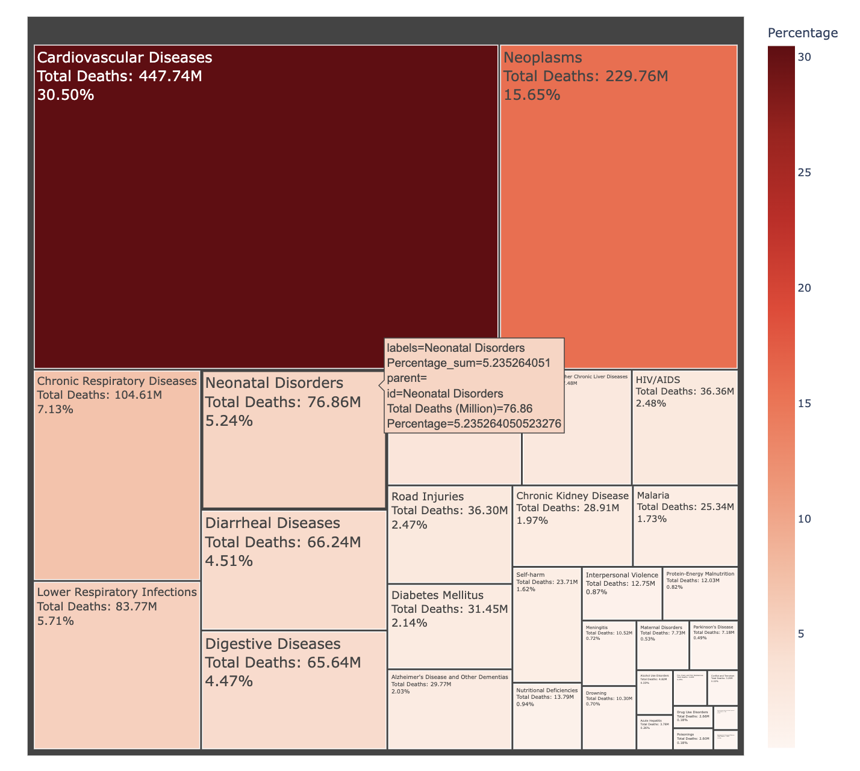
Global Causes of Death — Tree map Visualization
The Tree map visualization represents the percentage distribution of different causes of death worldwide.
Notes:
This visualization helps identify the leading causes of death globally, providing insights into: ✔ Public health priorities. ✔ Areas requiring urgent intervention. ✔ The overall burden of non-communicable and communicable diseases worldwide.

Slide 14
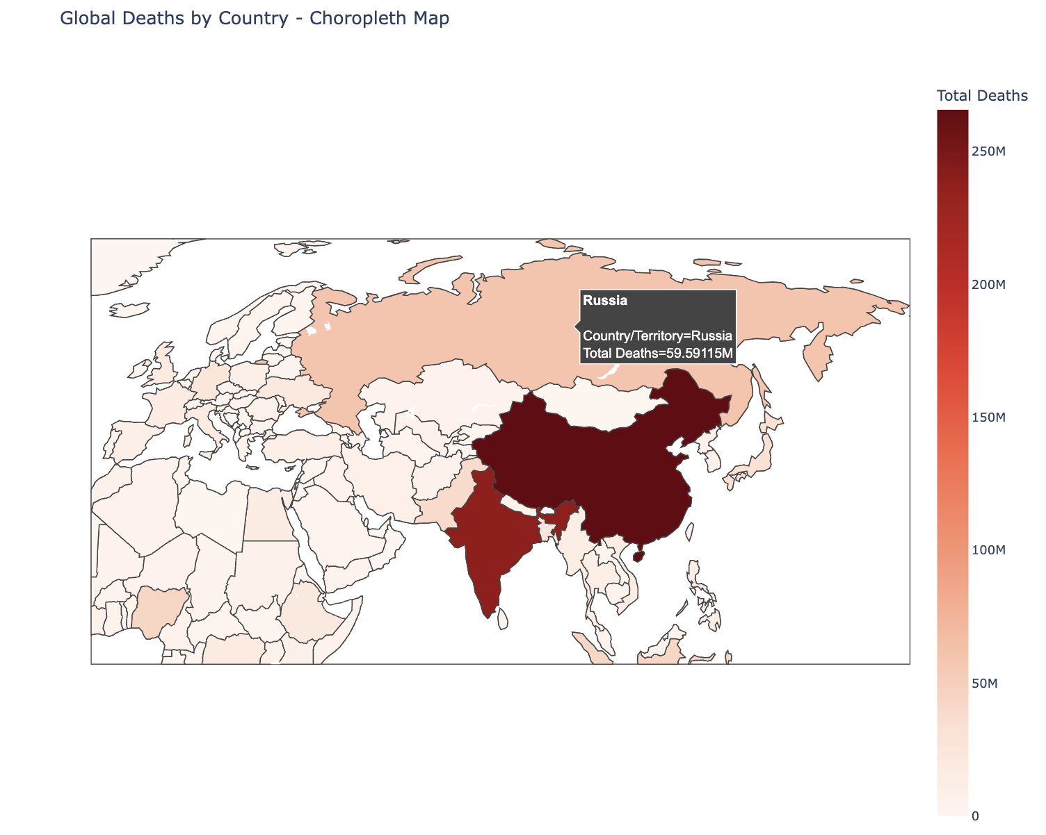
Global Deaths by Country
This map visualization represents the total number of deaths per country across all causes, providing an intuitive way to compare mortality rates globally.
Notes:
.This interactive visualization allows researchers, policymakers, and public health officials to: ✔ Identify high-risk regions with the highest mortality burdens. ✔ Analyze global health trends and variations across countries. ✔ Prioritize interventions in countries with the highest mortality rates.

Slide 15
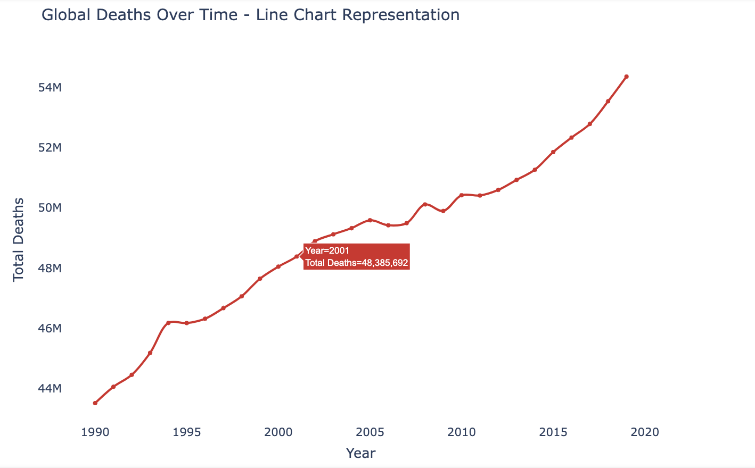
Global Mortality Trends Over Time
The visualization represents the total number of deaths per year across all causes, allowing users to explore trends in global mortality over time.
Notes:
The chart represents total global deaths over time, spanning from 1990 to 2020. The trend line is increasing, indicating a rise in global deaths over time.
Users can hover over each year to see the exact number of deaths.
✔ Increases in deaths due to pandemics, wars, or other global health crises. ✔ Fluctuations in mortality rates that may reflect public health improvements or disease outbreaks. ✔ Healthcare interventions and their impact across different time periods.

Slide 16
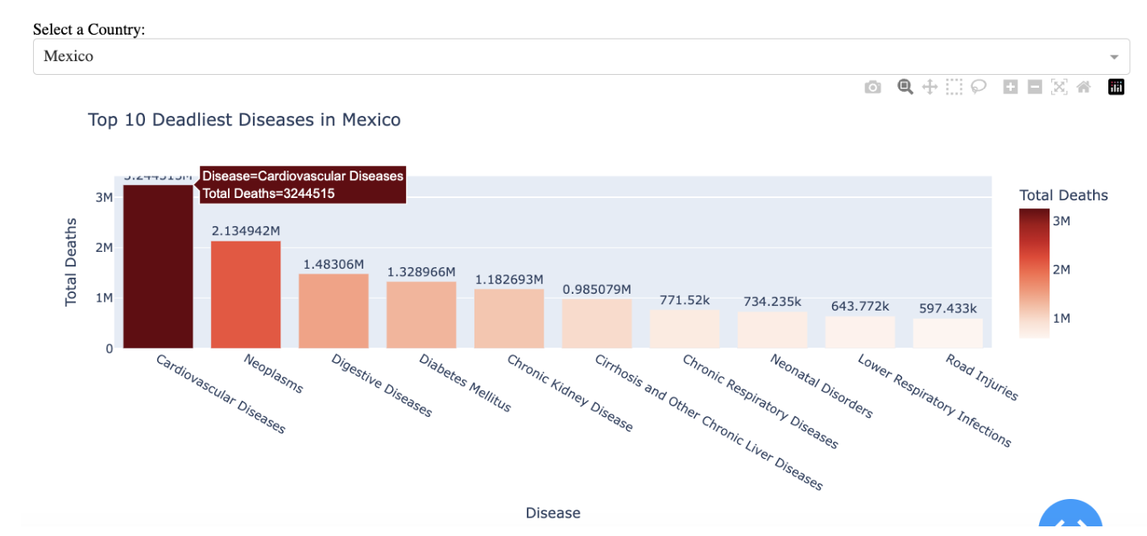
Top 10 Deadliest Diseases by Country
Notes:
Top 10 Deadliest Diseases by Country
The below interactive visualization represents the Top 10 Deadliest Diseases by Country using a bar chart.
The user can select a country from the dropdown menu, and this will display the bar chart to show the top 10 diseases causing the highest number of deaths in that country.

Slide 17
Conclusion
Global mortality trends show a rise in non-communicable diseases (NCDs), with cardiovascular diseases being the leading cause of death.
The study analyze that the deaths from infectious diseases have decreased over time due to advancements in medicine, vaccines, improved sanitation, and healthcare access.
However, Non-Communicable Diseases (NCDs) such as heart disease, cancer, and diabetes are increasing, mainly because of Aging Populations and Lifestyle Factors .
Public health policies should focus on preventive measures, such as lifestyle changes, healthcare improvements, and early interventions for NCDs.
Notes:
The statement means that deaths from infectious diseases (Communicable Diseases - CDs) such as tuberculosis, malaria, and pneumonia have decreased over time due to advancements in medicine, vaccines, improved sanitation, and healthcare access.
However, Non-Communicable Diseases (NCDs) such as heart disease, cancer, and diabetes are increasing, mainly because:
Aging Populations – As people live longer, they are more likely to develop chronic illnesses.
Lifestyle Factors – Poor diet, lack of exercise, smoking, alcohol consumption, and stress contribute to the rise in NCDs.

Slide 18
References
https://ourworldindata.org/causes-of-death
https://pmc.ncbi.nlm.nih.gov/articles/PMC10069753/
Link to dataset:https://ourworldindata.org/grapher/annual-number-of-deaths-by-cause
https://search.cdc.gov/search/?query=leading%20causes%20of%20death&dpage=1

